Slide 1
Intro to Data Science Project Phase-1 Telecom Churn Prediction
Team Members:
Ashwitha Reddy Nimmala--2313782
Sanjana Ponaganti--2312535
Azharmadani Syed--2316906
Venkata Sumanth Reddy Vangala--2311953
Shiva Shankar Bonda--2204797

Slide 2
Introduction
Telecom Churn Prediction
This project tells about the percentage of customers who are about to close their subscription with the network.
Why This Dataset:
Customer churn is a major problem and one of the most important concerns for large companies. Due to the direct effect on the revenues of the companies, especially in the telecom field, companies are seeking to develop means to predict potential customer to churn. Therefore, finding factors that increase customer churn is important to take necessary actions to reduce this churn. Machine learning has given enough potential algorithms to predict the customer churn and help the business in many ways.

Slide 3
About Dataset
We have collected the dataset from Kaggle.
It is having 58 attributes and 50k instances
Attributes are :
Customer id Monthly revenue
Monthly minutes Total recurring charge
Director assisted calls Overage minutes
Roaming calls Perchange minutes
Per change revenue Dropped calls
Blocked calls Unanswered calls
Customer care calls Three way calls

Slide 4
Received calls Outbound calls
Inbound calls Peak calls in-out
Off peak calls in out Dropped blocked calls
Call forwading calls Call waiting calls
Months in service Unique subs
Active subs Handsets
Handset models Current equipment days
Age HH1 Age HH2
Retention calls Retention Offers accepted
Referrals made by subscriber Income group
Adjustments to credit rating
Target Variable:
Churn

Slide 5
Project overview
Data Cleaning:
In this step, we tried to find the missing values, null values and outliers in the attributes.
Then we deleted some of the instances with more missing values and replaced some with mean/median/mode
For the categorical data we have replaced the null or missing values with mode.
EDA
Here we have visualized the data using various plots like bar, scatter, heatmap, pair plot, box plot etc.., to identify the relation between the variables as well as the outliers.

Slide 6
Model building:
Since this is a classification problem, we will be building a Logistic Regression as the base model and then building a Random forest or any other high end algorithm.
Prediction and evaluation:
Once we have build the model, we will be using the testing data and predict the outcomes then we will be evaluating the model using metrices like confusion matrix, accuracy, F1-score etc..

Slide 7
Methodology
We will be using algorithms like:
Decision tree
Random forest
XGB boost
Logistic Regression

Slide 8
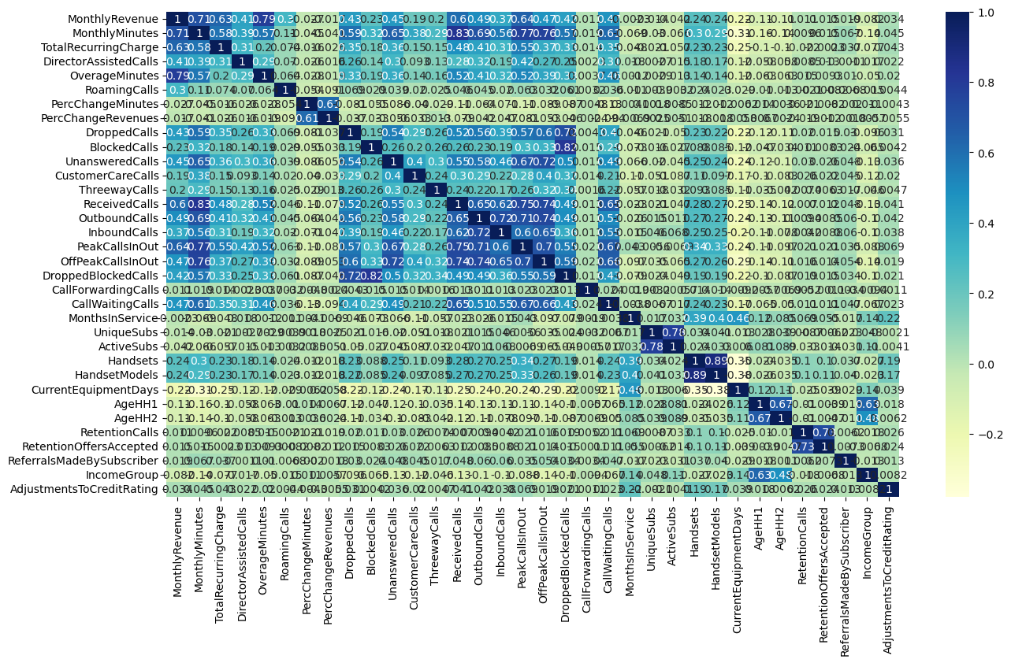
Results
Data Preprocessing:

Slide 9
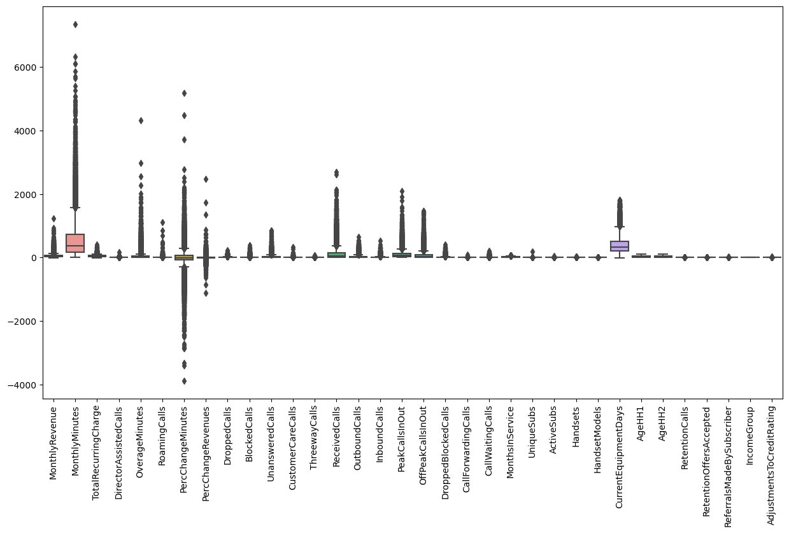
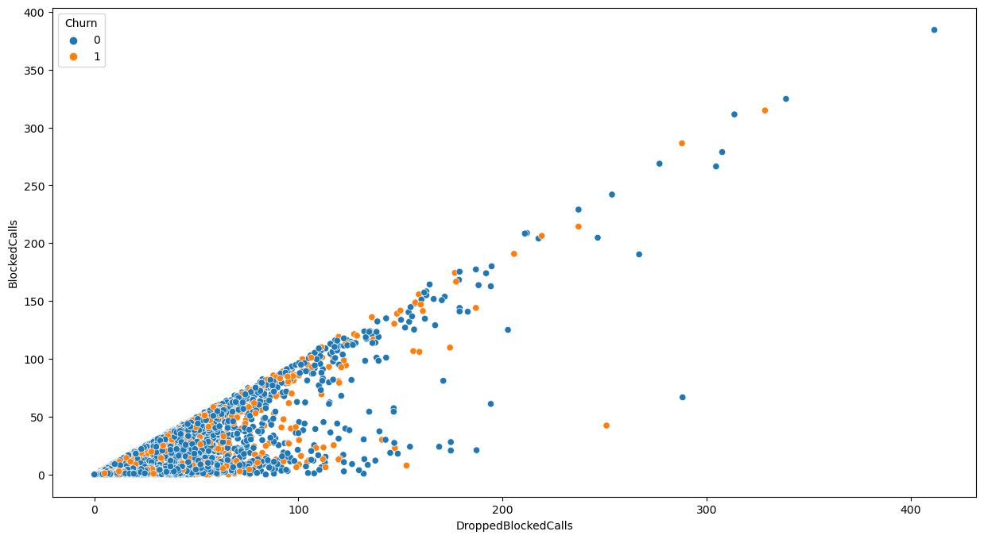

Slide 10
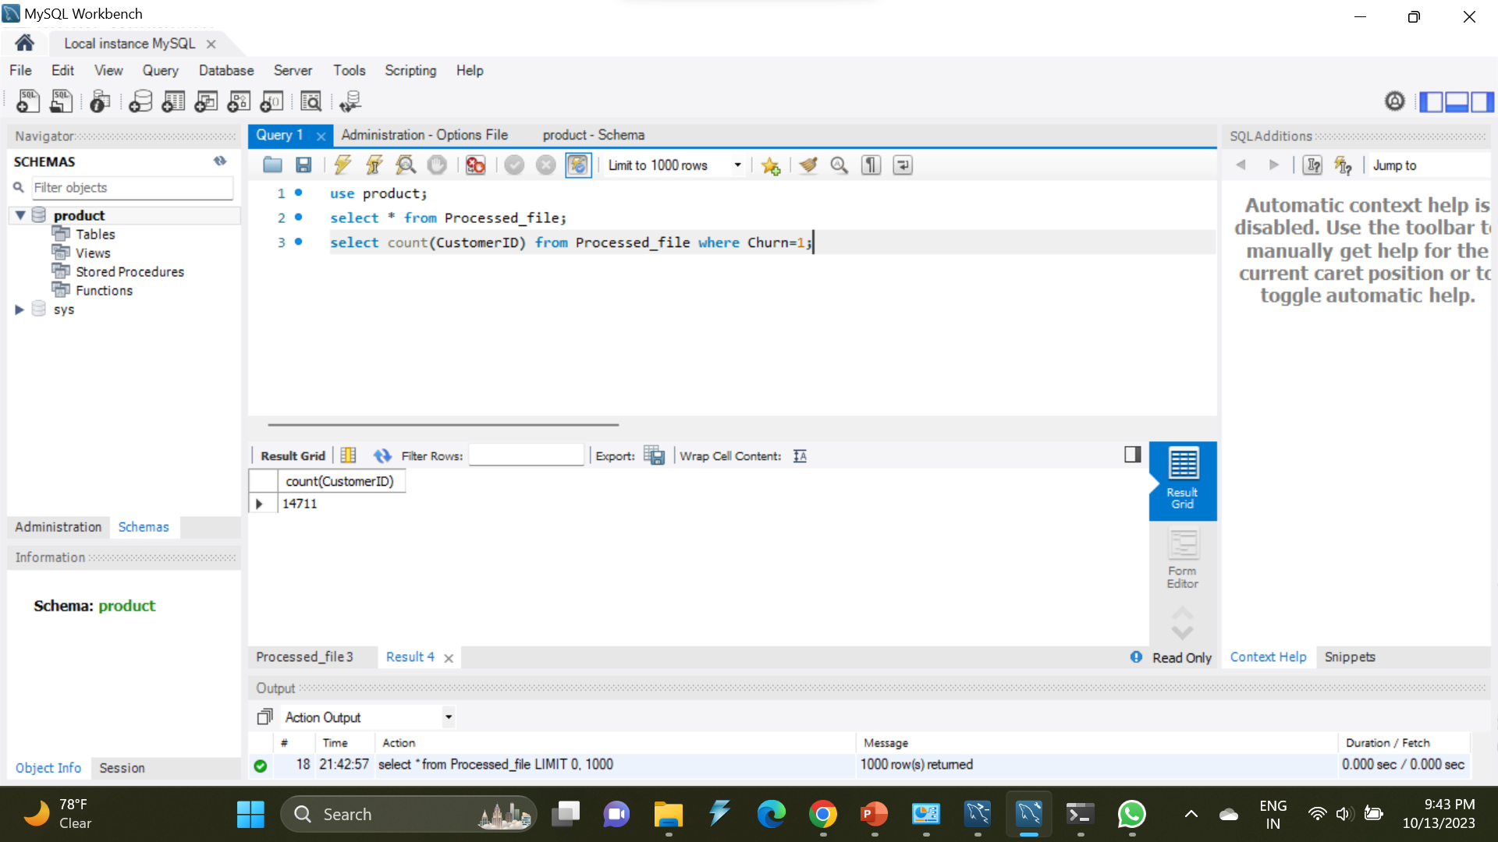
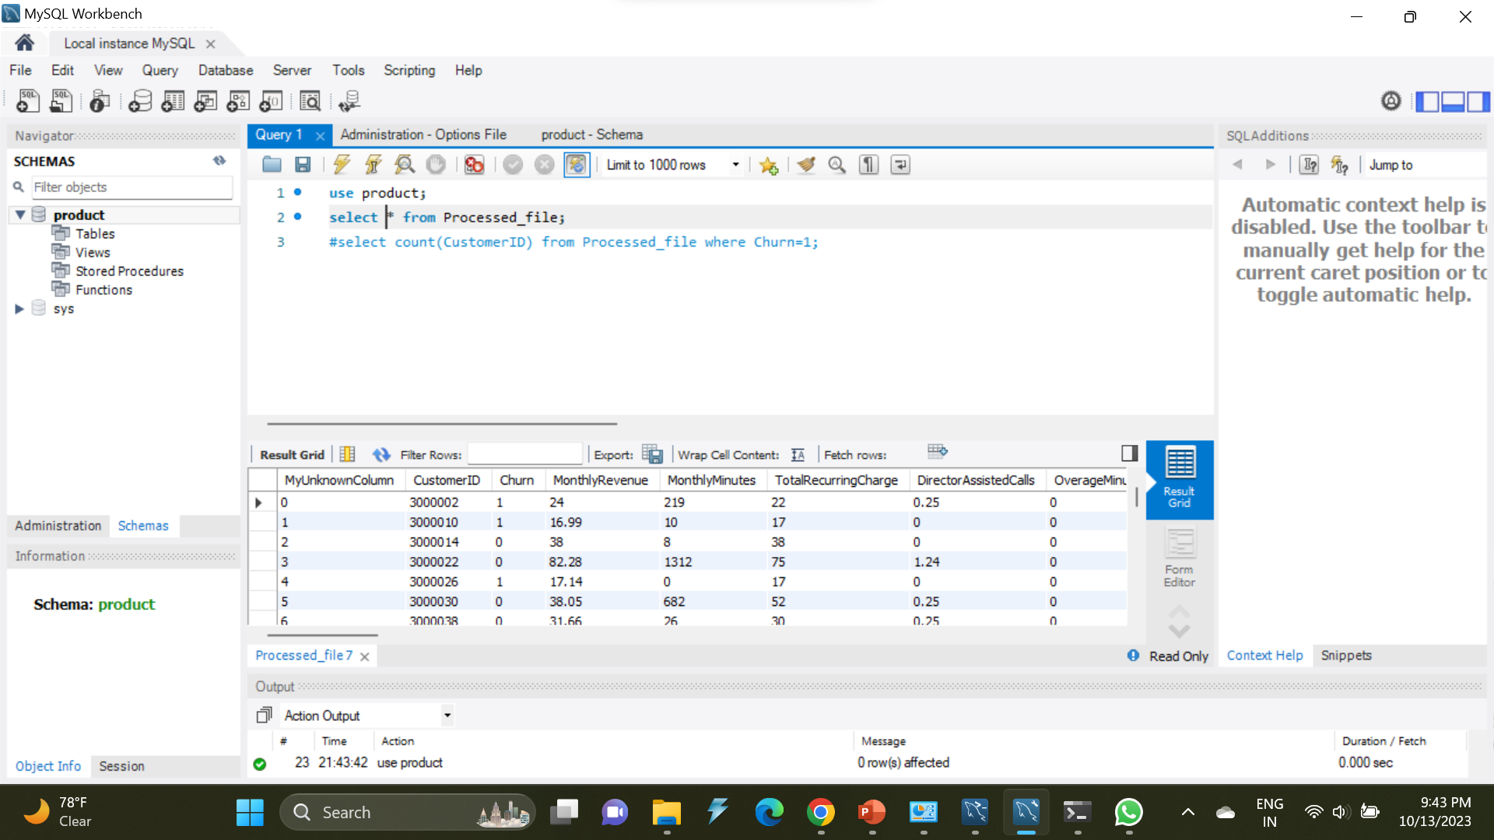
SQL queries

Slide 11
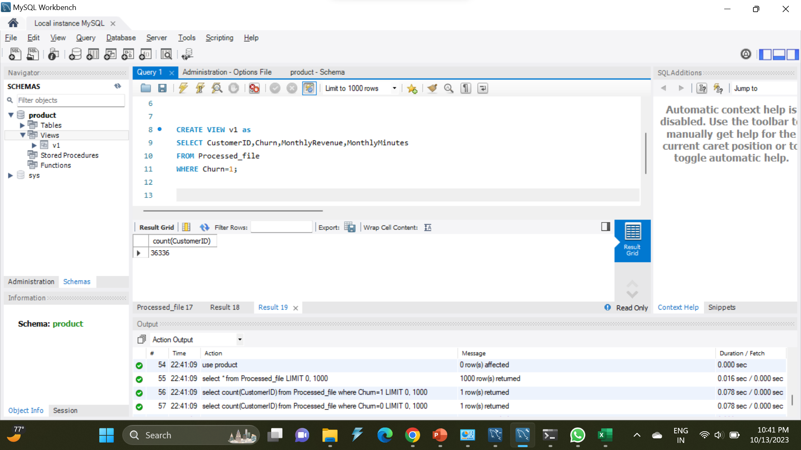
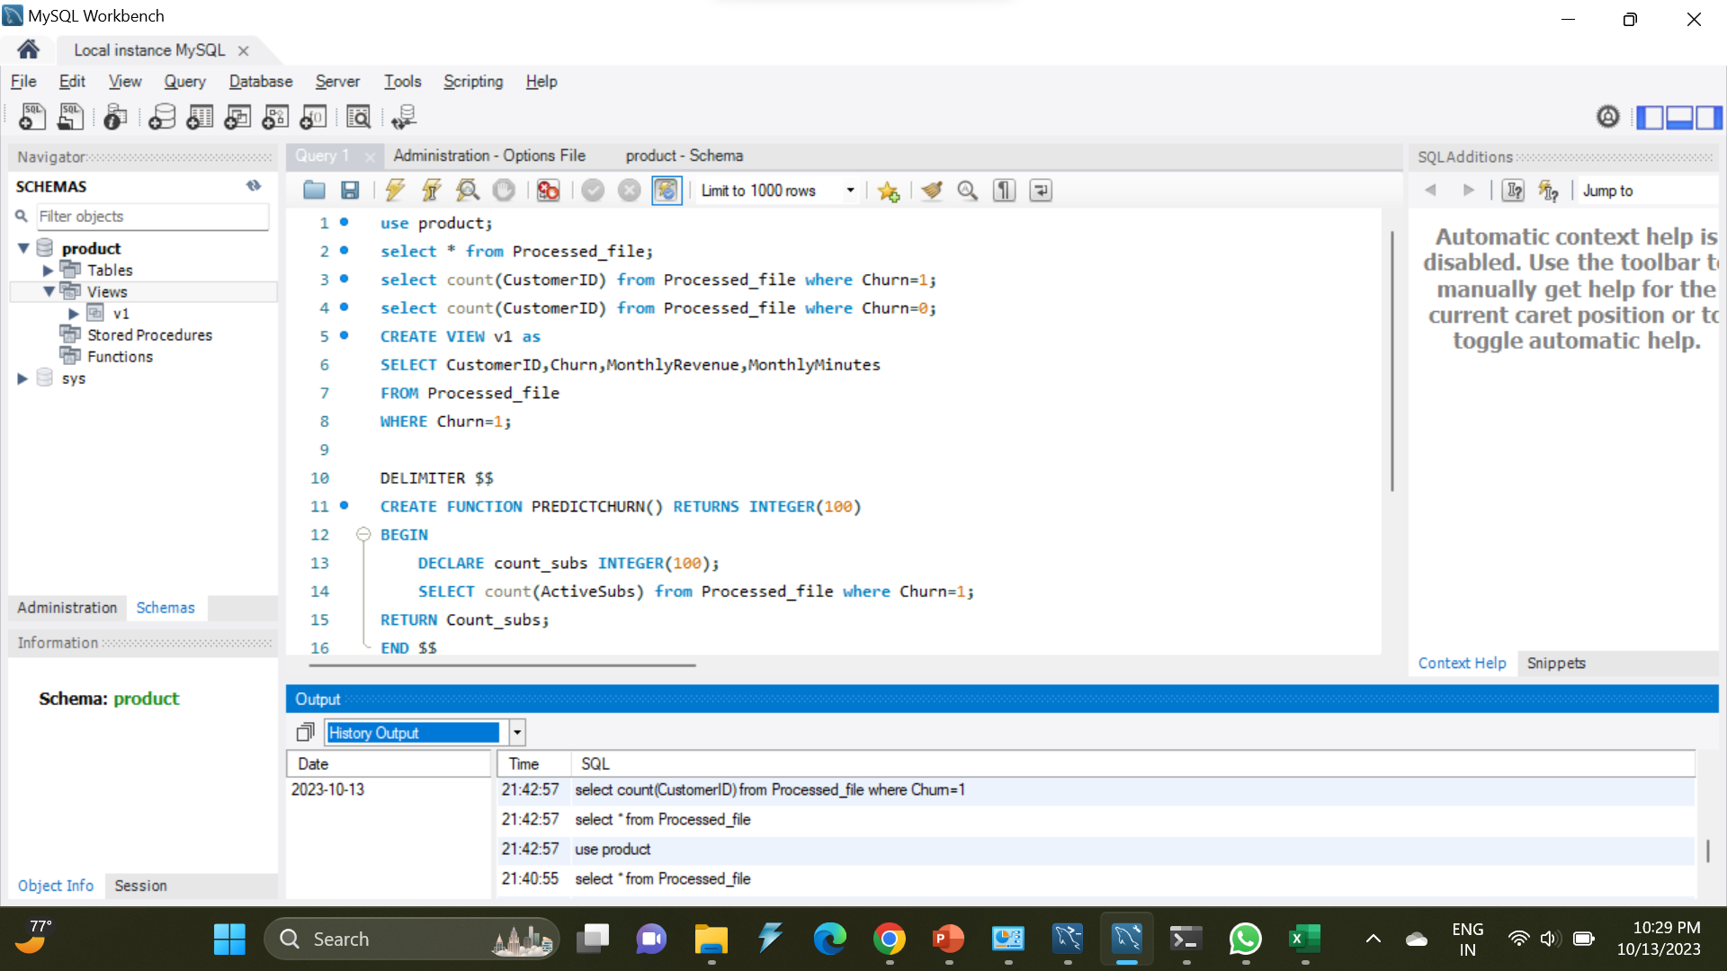

Slide 12
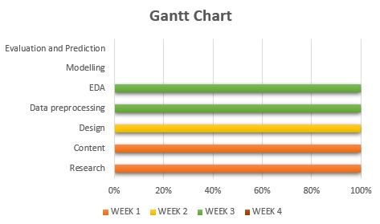

Slide 13
THANK YOU

